Slide 1
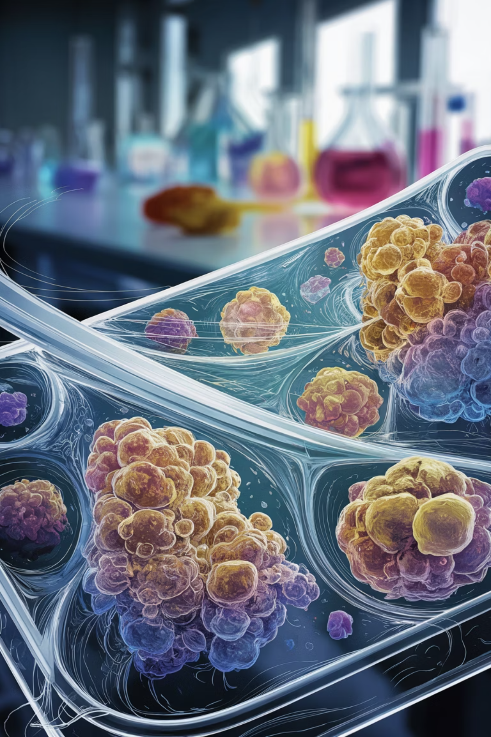
PathVQA: Data Preprocessing Pipeline
A walkthrough of text cleaning, tokenization, label encoding, and image preprocessing for the PathVQA dataset — a vision-and-language benchmark built on pathology images paired with clinical questions.
FLAVIAGIAMMARINO/PATH-VQA
HUGGINGFACE DATASETS
VILT

Slide 2
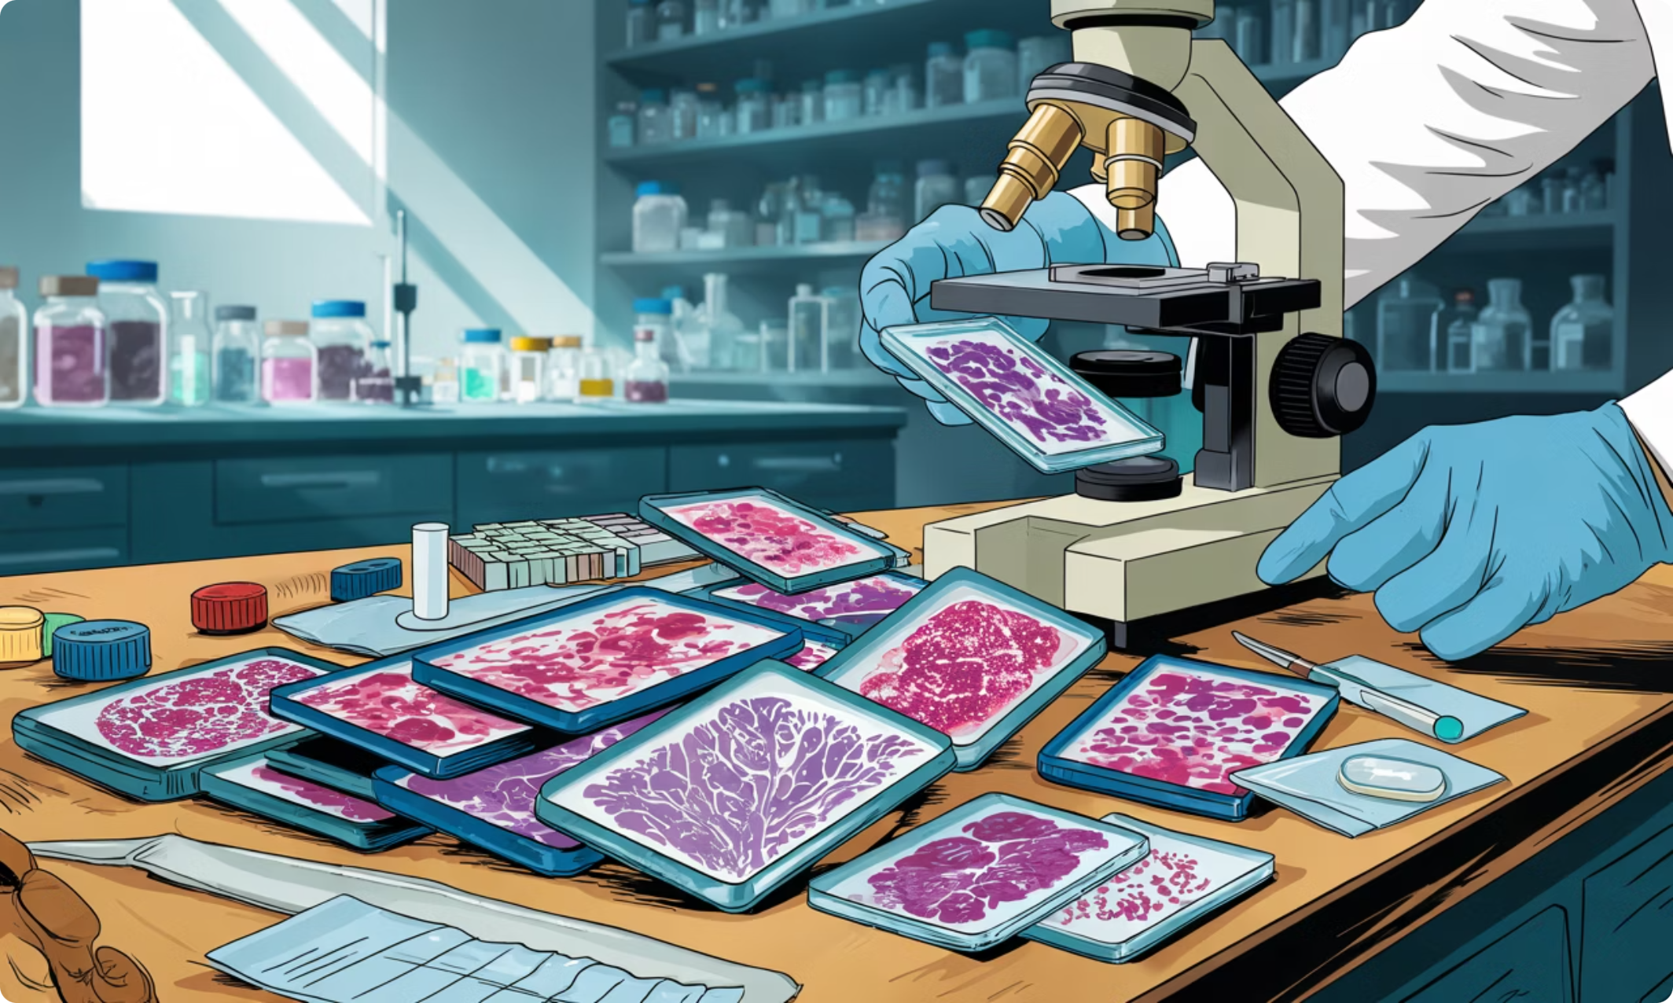
About the PathVQA Dataset
What is PathVQA?
PathVQA is a medical Visual Question Answering dataset composed of pathology images paired with clinically grounded questions. It tests a model's ability to interpret microscopic tissue images and answer both yes/no and open-ended questions.
Train / Validation / Test splits available
Questions span color, location, morphology, and presence of structures
Answers range from binary ("yes"/"no") to free-form text
Hosted on HuggingFace as flaviagiammarino/path-vqa

Slide 3
Loading the Dataset
What This Does
from datasets import load_dataset
ds = load_dataset(
"flaviagiammarino/path-vqa",
cache_dir="E:/huggingface_cache"
)
# Splits: train, validation, test
print(ds)
The load_dataset call downloads all three splits — train, validation, and test — and caches them locally to avoid repeated downloads. Each example contains three fields:
image
question
answer
PIL Image object
Raw string
Raw string label

Slide 4

Step 1 — Text Cleaning & Normalization
Raw text from crowdsourced or medical annotations is often noisy. A consistent normalization function is applied to both questions and answers before any modeling.

Slide 5
Text Cleaning: Code Walkthrough
Operations Applied
import re
def clean_text(text):
if text is None: return ""
text = str(text).lower()
text = text.strip()
text = re.sub(r"\s+", " ", text)
text = re.sub(r"[^\w\s]", "", text)
return text
def preprocess_text(example):
example["question"] = clean_text(example["question"])
example["answer"] = clean_text(example["answer"])
return example
clean_ds = ds.map(preprocess_text)
Lowercase
Reduces vocabulary size and avoids case-sensitive duplicates
Strip & Collapse Whitespace
Removes leading/trailing spaces and collapses internal whitespace
Punctuation Removal
Strips all non-word, non-space characters via regex

Slide 6

Step 2 — Building the Answer Vocabulary
Why Top-K?
from collections import Counter
TOP_K_ANSWERS = 1250
answer_counts = Counter(
clean_ds["train"]["answer"]
)
most_common_answers = [
answer for answer, count
in answer_counts.most_common(TOP_K_ANSWERS)
]
answer2id = {
answer: idx
for idx, answer
in enumerate(most_common_answers)
}
id2answer = {
idx: answer
for answer, idx in answer2id.items()
}
VQA is framed as multi-class classification. Instead of generative decoding, we predict over a fixed vocabulary of the 1,250 most frequent training answers. Rare answers are filtered out to reduce noise and class imbalance.
The resulting answer2id and id2answer dicts serve as the bidirectional mapping between string labels and integer class indices throughout training and evaluation.

Slide 7


Step 3 — Filtering Rare Answers
What Gets Removed?
from datasets import DatasetDict
valid_answers = set(answer2id.keys())
def keep_top_answers(example):
return example["answer"] in valid_answers
filtered_ds = DatasetDict({
split: clean_ds[split].filter(keep_top_answers)
for split in clean_ds.keys()
})
# Retention summary
for split in filtered_ds:
original = len(clean_ds[split])
kept = len(filtered_ds[split])
pct = kept / original
print(f"{split}: {kept:,}/{original:,} ({pct:.1%})")
Any example whose answer does not appear in the top-8,000 vocabulary is dropped. This keeps the label space tractable and removes extremely rare or malformed answers.
Typical retention is >95% of training examples — the long tail of answers is small but noisy.
Validation and test sets are filtered using the training vocabulary only to prevent label leakage.

Slide 8

Step 4 — Adding Numeric Labels
Integer Labels for PyTorch
Each string answer is replaced with its corresponding integer index. This label field is later used directly as the target in CrossEntropyLoss during fine-tuning.
def add_label(example):
example["label"] = answer2id[example["answer"]]
return example
labeled_ds = filtered_ds.map(add_label)
print(labeled_ds["train"][0])
# {
# "question": "what color is the tissue",
# "answer": "pink",
# "label": 3
# }
String to Integer
"pink" → answer2id → 3
Answer↔ID Mapping
Integer to String
3 → id2answer → "pink"

Slide 9
Step 5 — Tokenization & Image Preprocessing
ViLT Processor Outputs
from transformers import ViltProcessor
processor = ViltProcessor.from_pretrained(
"dandelin/vilt-b32-mlm"
)
def preprocess_for_vilt(example):
encoding = processor(
images=example["image"].convert("RGB"),
text=example["question"],
padding="max_length",
truncation=True,
max_length=40,
return_tensors="pt"
)
return {
"input_ids": encoding["input_ids"].squeeze(),
"attention_mask": encoding["attention_mask"].squeeze(),
"token_type_ids": encoding["token_type_ids"].squeeze(),
"pixel_values": encoding["pixel_values"].squeeze(),
"pixel_mask": encoding["pixel_mask"].squeeze(),
"labels": example["label"]
}
processed_ds = labeled_ds.map(
preprocess_for_vilt,
remove_columns=labeled_ds["train"].column_names
)
input_ids
attention_mask
Tokenized question IDs (padded to 40)
1s for real tokens, 0s for padding
token_type_ids
pixel_values
Segment IDs for text vs. image
Normalized image patches tensor
pixel_mask
Mask for valid image regions

Slide 10

Pipeline Summary
Load Dataset
1
load_dataset with train/val/test splits
Clean Text
2
Lowercase, strip, collapse whitespace, remove punctuation
Build Vocabulary
3
Top-1,250 answers → answer2id / id2answer
Filter & Label
4
Drop rare answers, add integer label field
ViLT Preprocessing
5
Tokenize questions + patch images → PyTorch tensors
The processed dataset is now ready for fine-tuning ViLT on PathVQA as a closed-set classification task over 8,000 answer classes.

